Slide 1
Numerical Methods
Solution of Systems of Linear Equations Chapter 9-12
Read Chapter 9 of the textbook
Dr Akhter Raza

Slide 2
Vector, Matrices, and
Linear Equations
Dr Akhter Raza

Slide 3
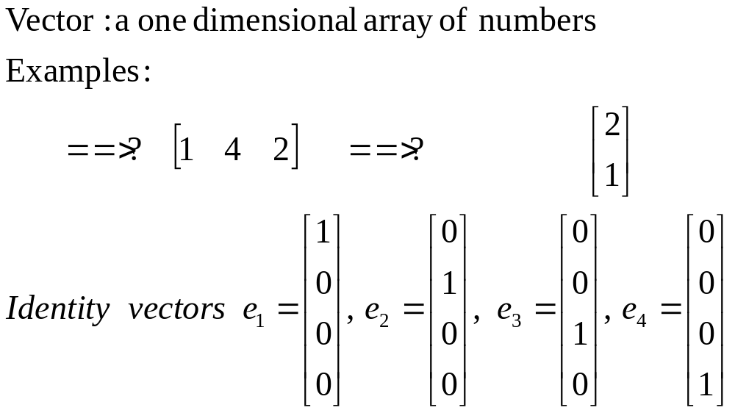
VECTORS
Dr Akhter Raza

Slide 4
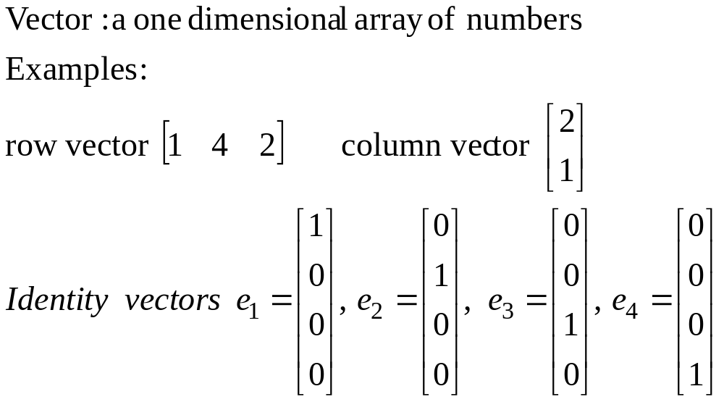
VECTORS
Dr Akhter Raza

Slide 5
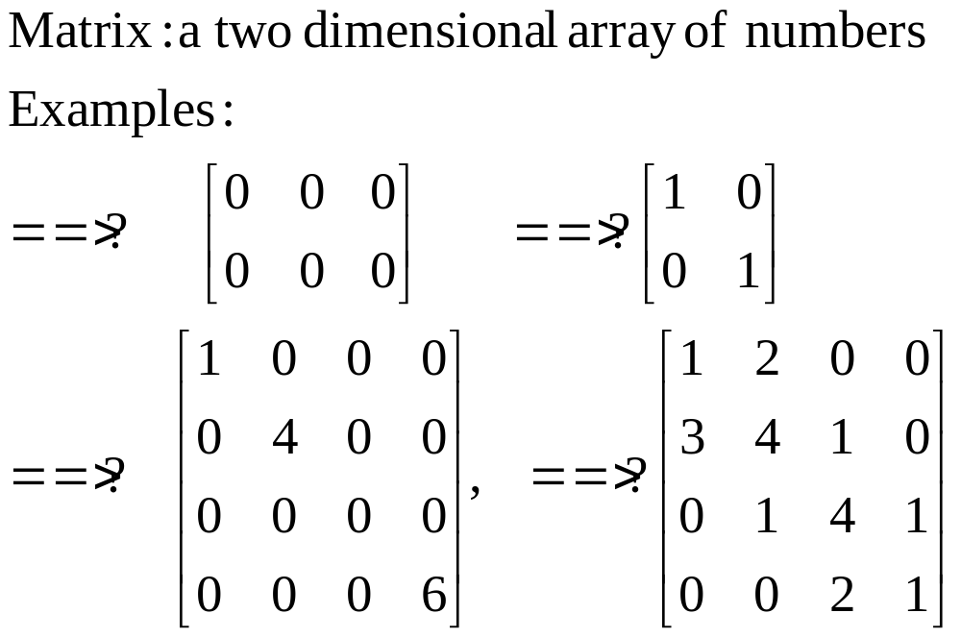
MATRICES
Dr Akhter Raza

Slide 6
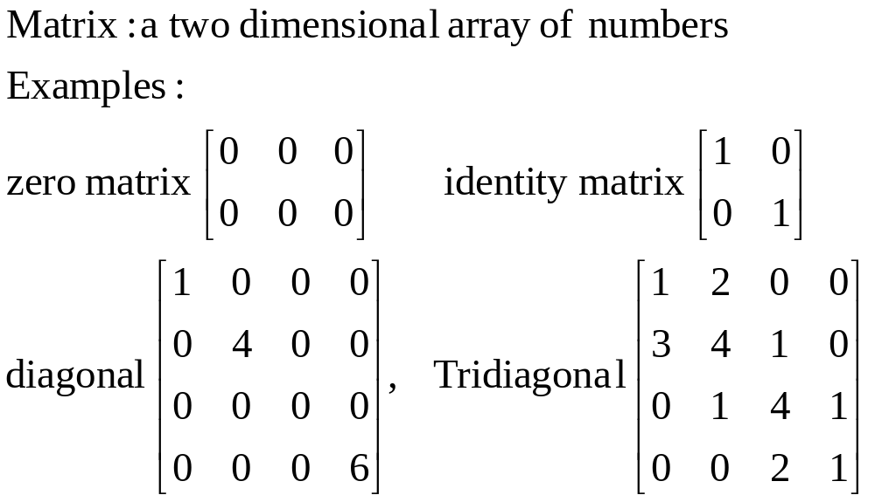
MATRICES
Dr Akhter Raza

Slide 7
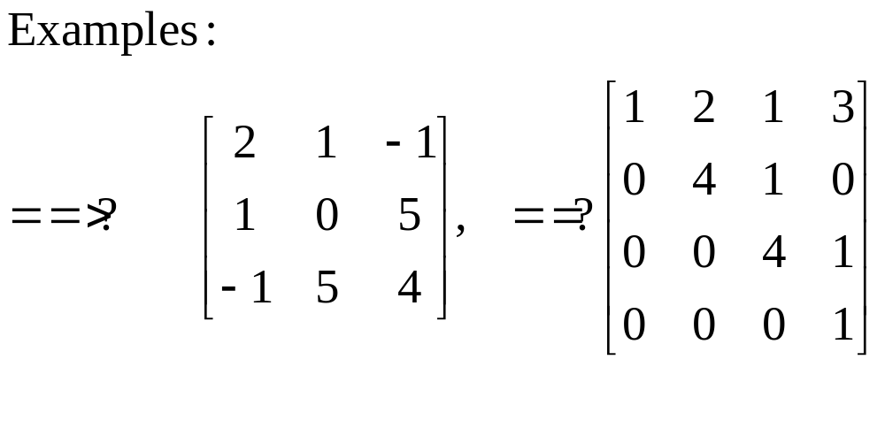
MATRICES
Dr Akhter Raza

Slide 8
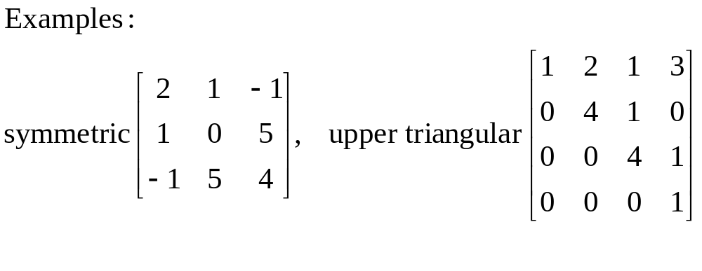
MATRICES
Dr Akhter Raza

Slide 9
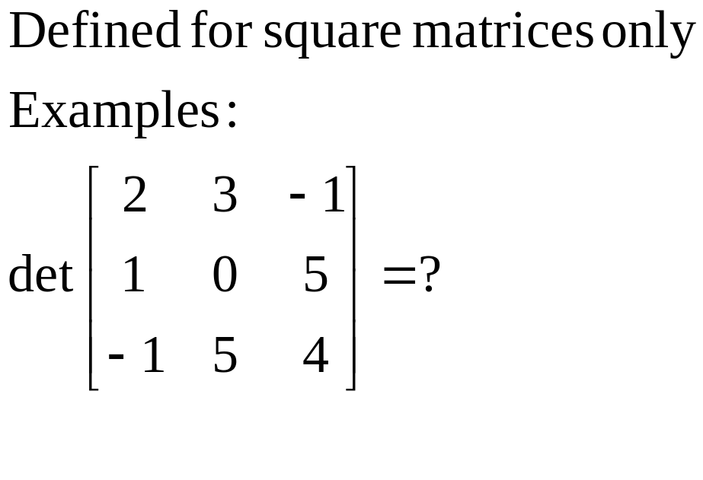
Determinant of a MATRICES
Dr Akhter Raza

Slide 10
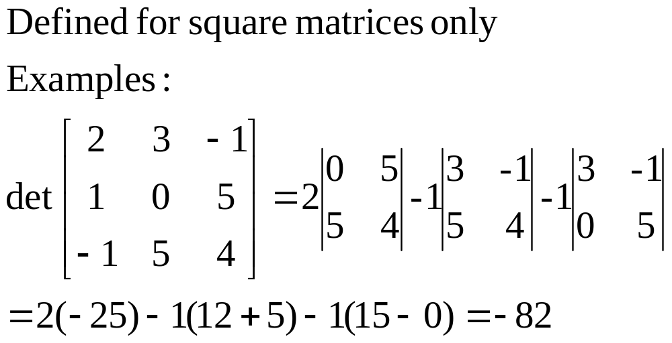
Determinant of a MATRICES
Dr Akhter Raza

Slide 11
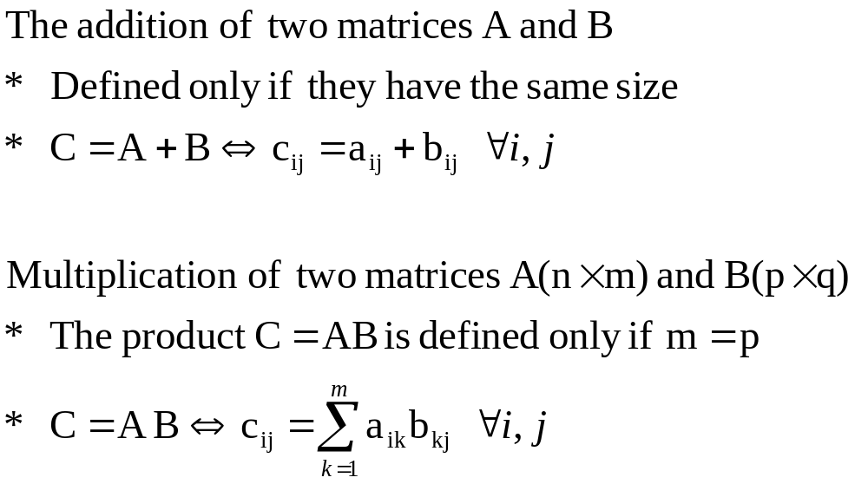
Adding and Multiplying Matrices
Dr Akhter Raza

Slide 12
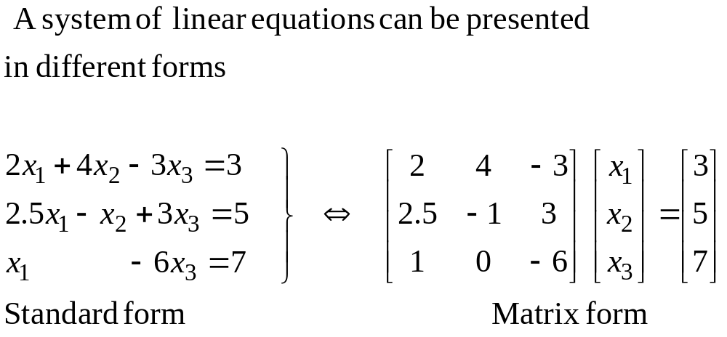
Systems of Linear Equations
Dr Akhter Raza

Slide 13
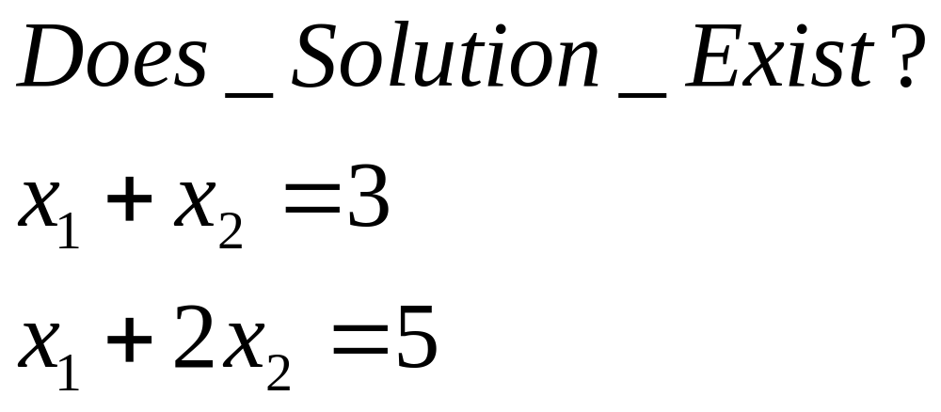
Solutions of Linear Equations
Dr Akhter Raza

Slide 14
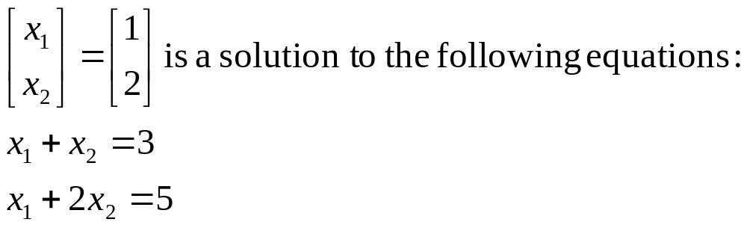
Solutions of Linear Equations
Dr Akhter Raza

Slide 15
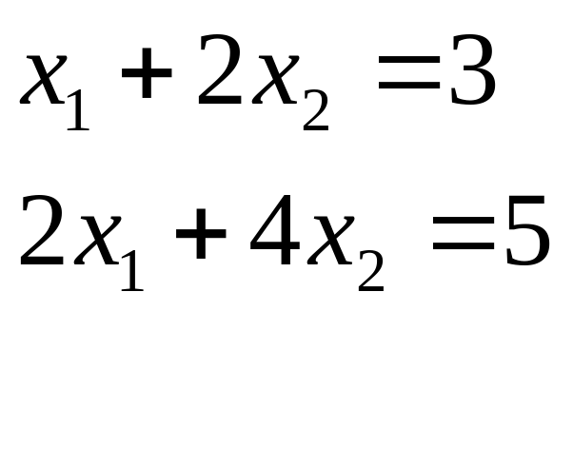
Solutions of Linear Equations
Does solution exist?
Dr Akhter Raza

Slide 16
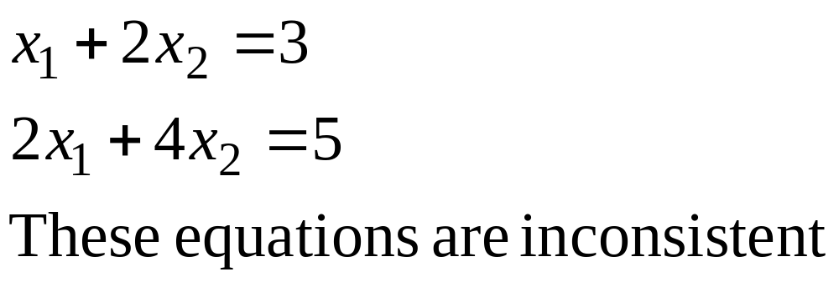
Solutions of Linear Equations
A set of equations is inconsistent if there exists no solution to the system of equations:
Dr Akhter Raza

Slide 17
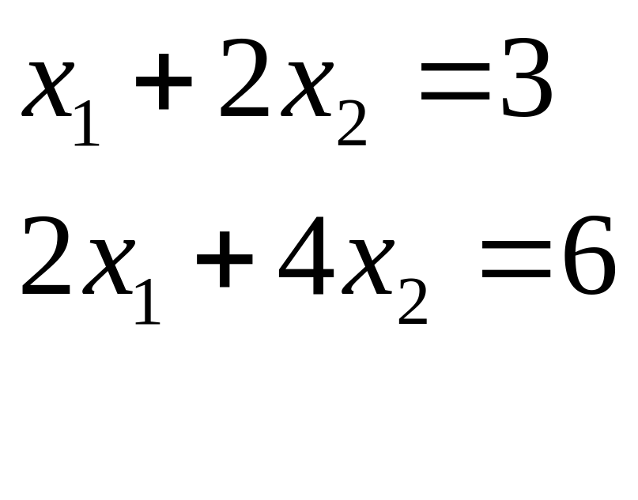
Solutions of Linear Equations
Does Solution Exist?
Dr Akhter Raza

Slide 18
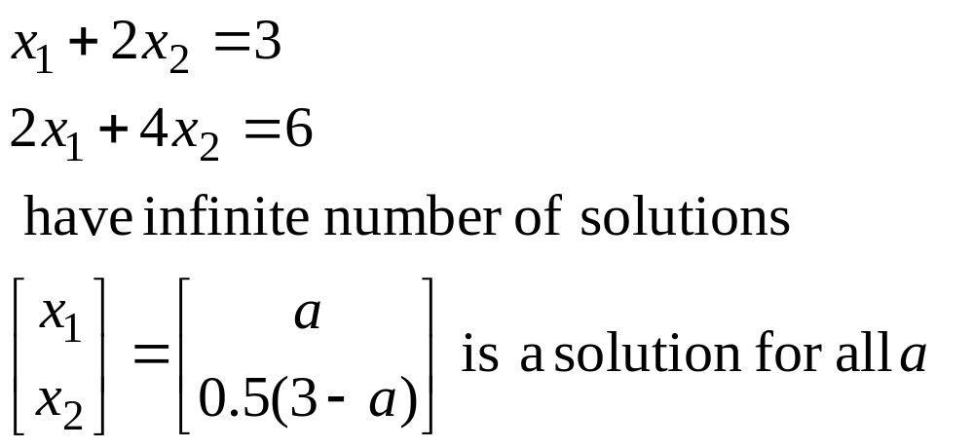
Solutions of Linear Equations
Some systems of equations may have infinite number of solutions
Dr Akhter Raza

Slide 19
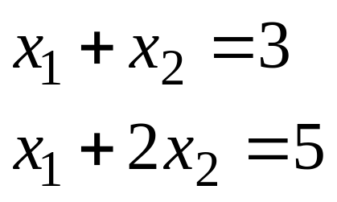
Graphical Solution of Systems of
Linear Equations
Solution
x₁=1, x₂=2
Dr Akhter Raza

Slide 20
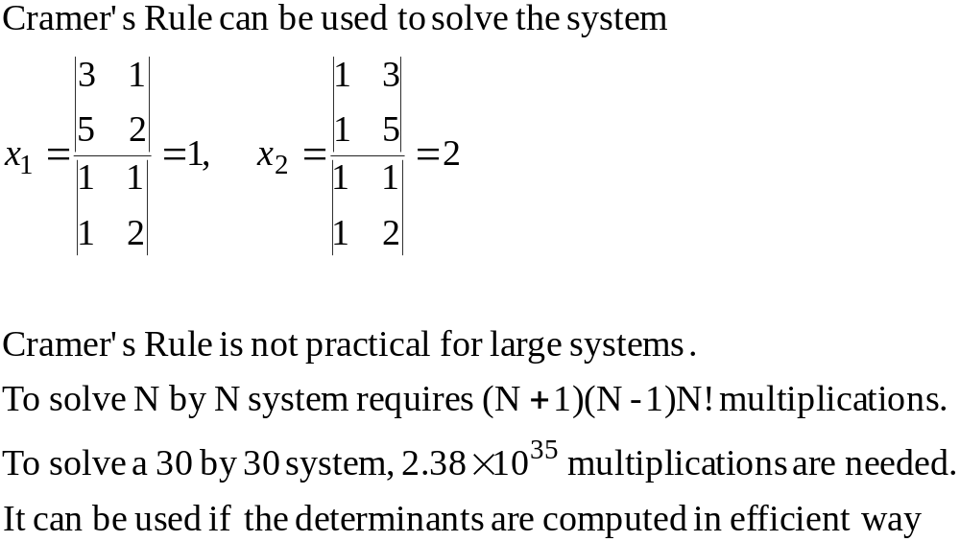
Cramer’s Rule is Not Practical
Dr Akhter Raza

Slide 21
Lecture 13
Naive Gaussian Elimination
Naive Gaussian Elimination
Examples
Dr Akhter Raza

Slide 22
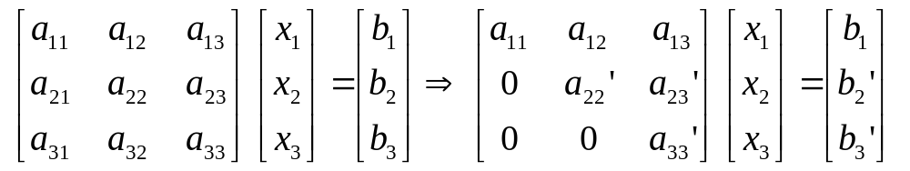
Naive Gaussian Elimination
The method consists of two steps:
  Forward Elimination: the system is reduced to upper triangular form. A sequence of elementary operations is used.
  Backward Substitution: Solve the system starting from the last variable.
Dr Akhter Raza

Slide 23
Elementary Row Operations
Adding a multiple of one row to another
Multiply any row by a non-zero constant
Dr Akhter Raza

Slide 24
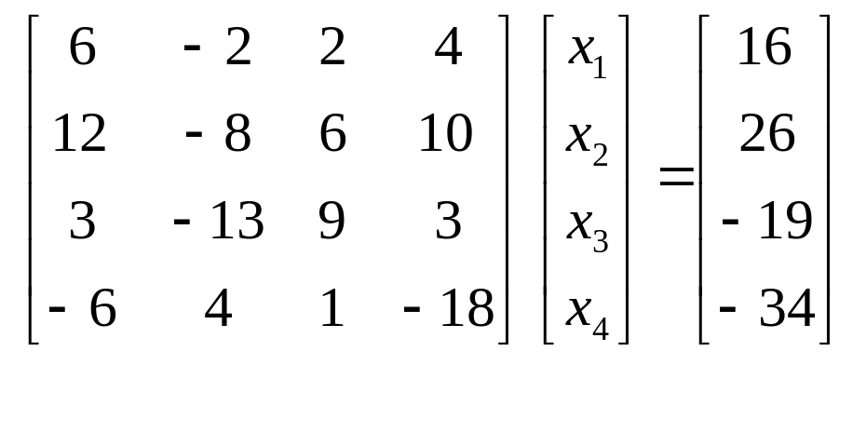
Example
Forward Elimination
Solve the following system by Guassian method
Dr Akhter Raza

Slide 25
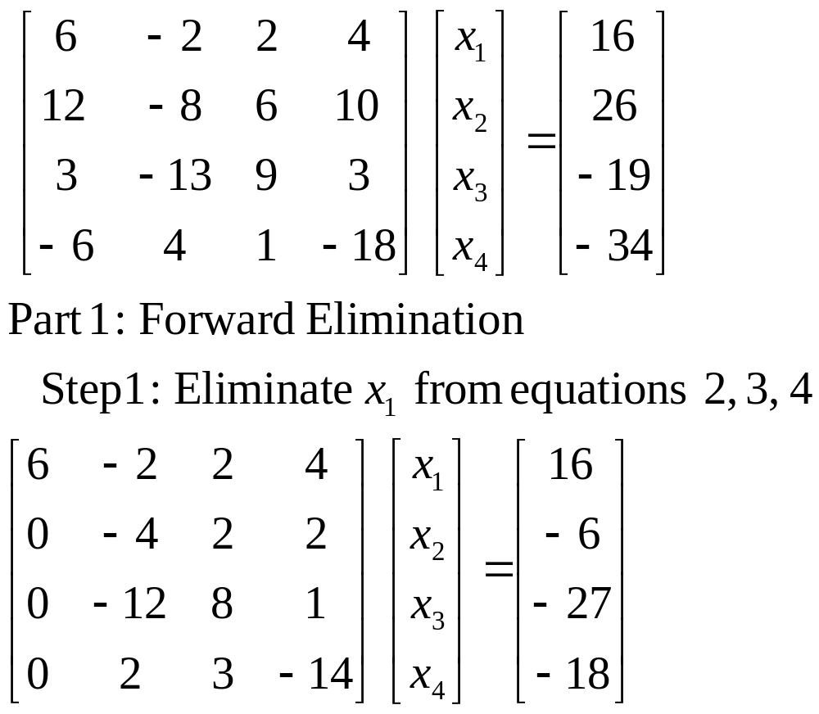
Example
Forward Elimination
Dr Akhter Raza

Slide 26
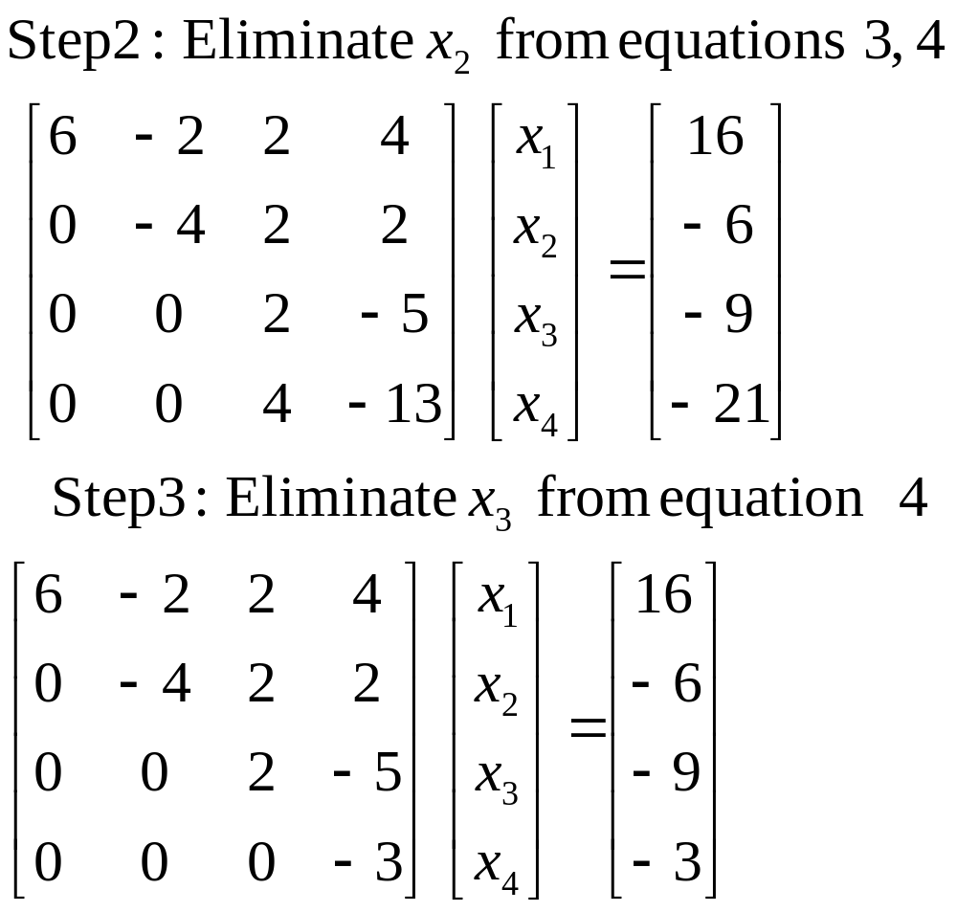
Example
Forward Elimination
Dr Akhter Raza

Slide 27
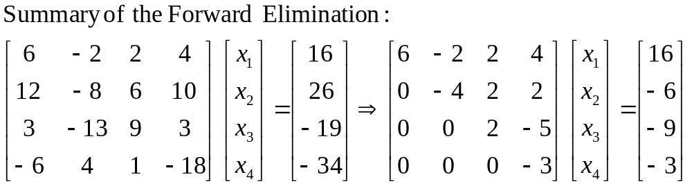
Example
Forward Elimination
Dr Akhter Raza

Slide 28
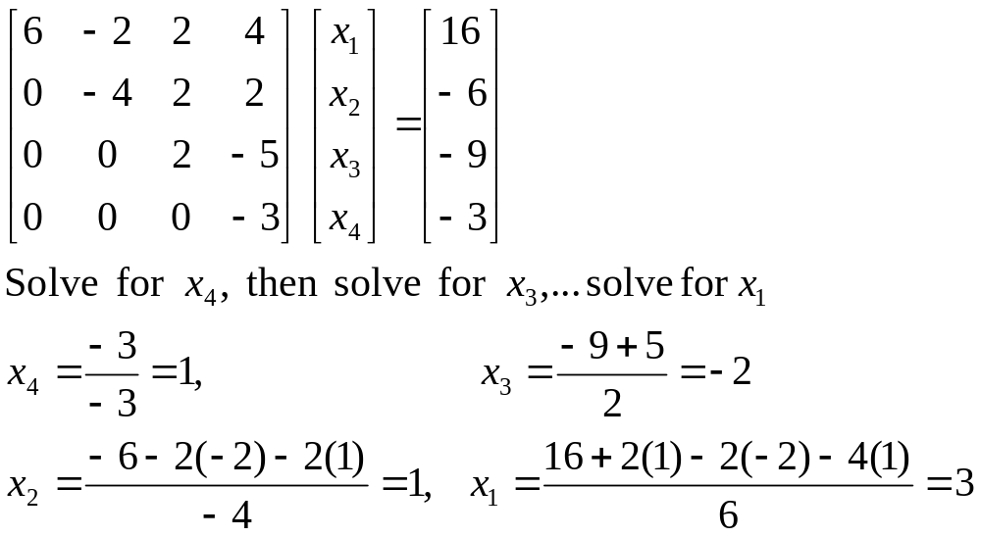
Example
Backward Substitution
Dr Akhter Raza

Slide 29
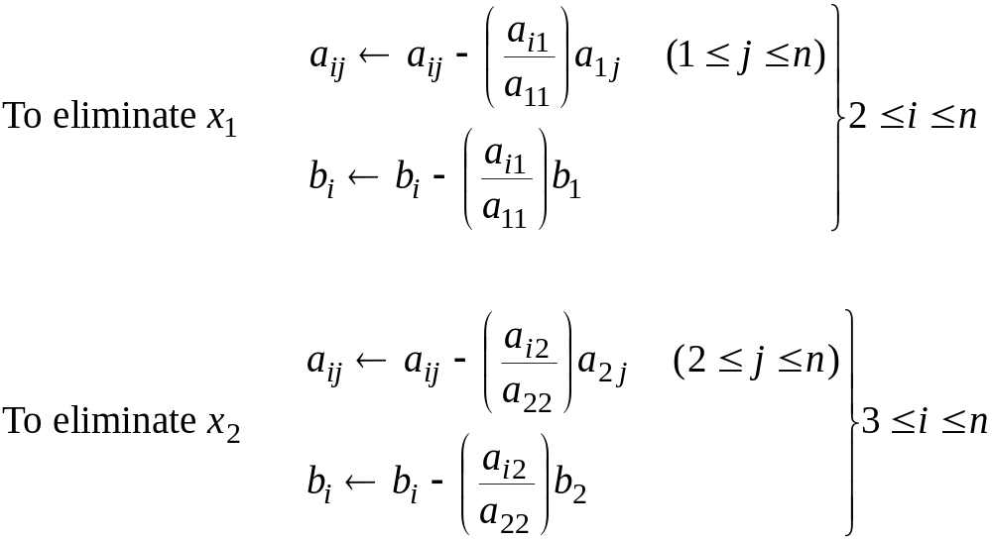
Forward Elimination
Dr Akhter Raza

Slide 30
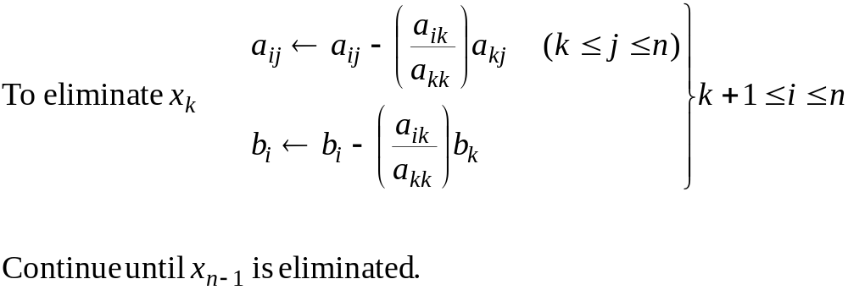
Forward Elimination
Dr Akhter Raza

Slide 31
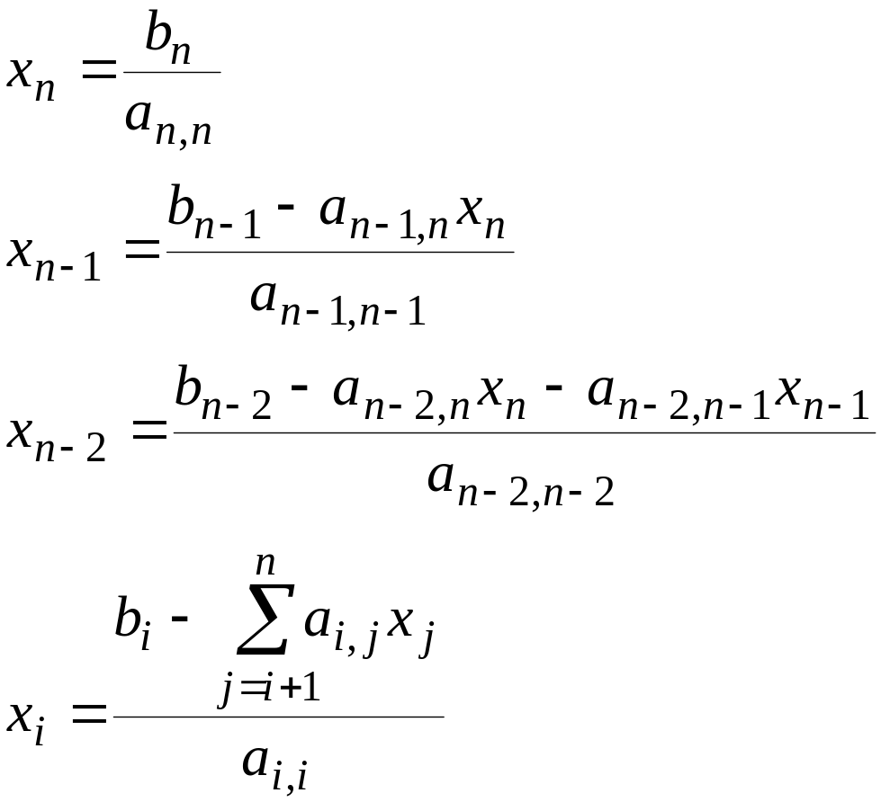
Backward Substitution
Dr Akhter Raza

Slide 32
Lecture 14
Naive Gaussian Elimination
Summary of the Naive Gaussian Elimination
Example
Problems with Naive Gaussian Elimination
  Failure due to zero pivot element
  Error
Pseudo-Code
Dr Akhter Raza

Slide 33
Naive Gaussian Elimination
The method consists of two steps
  Forward Elimination: the system is reduced to upper triangular form. A sequence of elementary operations is used.
  Backward Substitution: Solve the system starting from the last variable. Solve for x_{n} ,x_{n-1},…x_{1.}
Dr Akhter Raza

Slide 34
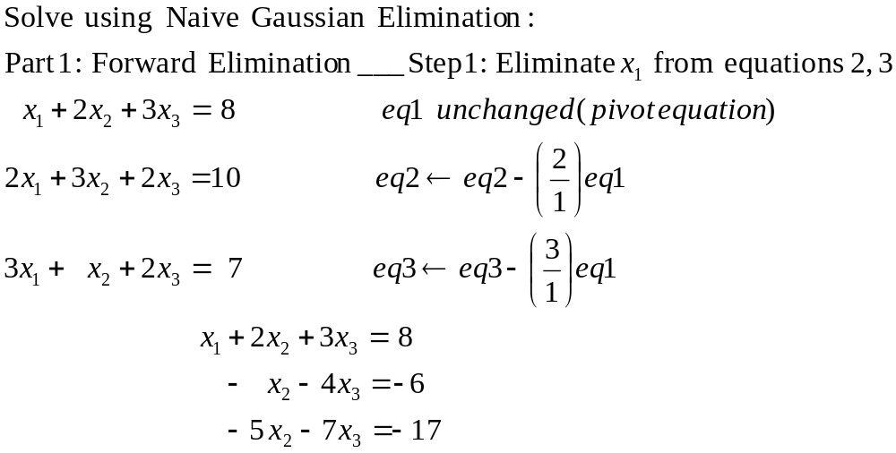
Example 1
Dr Akhter Raza

Slide 35
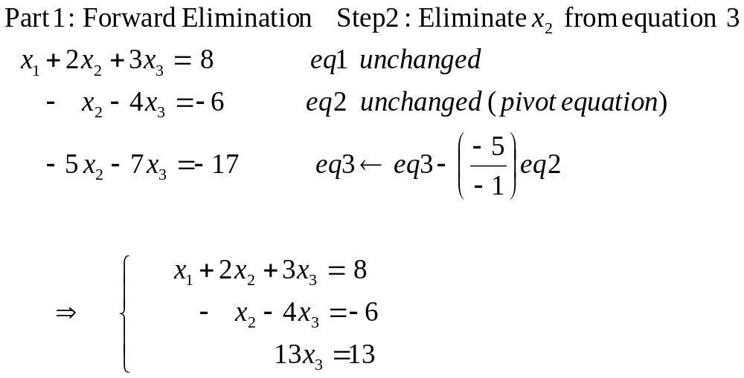
Example 1
Dr Akhter Raza

Slide 36
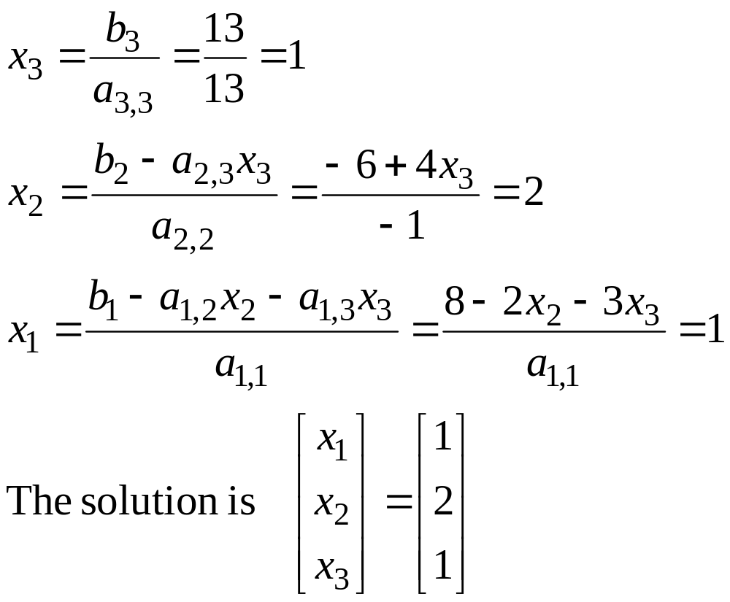
Example 1
Backward Substitution
Dr Akhter Raza

Slide 37
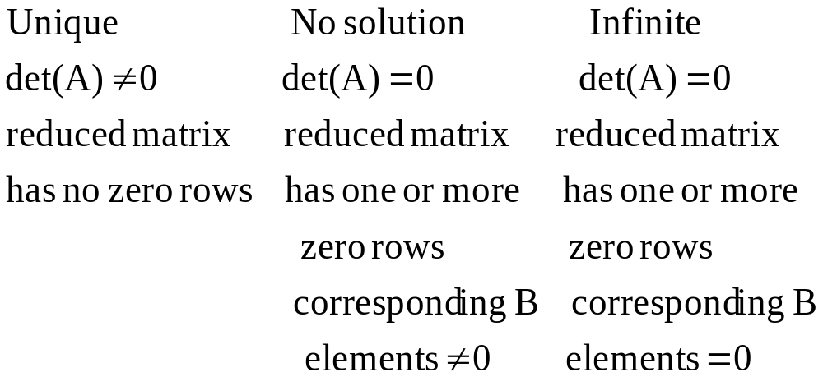
How Many Solutions Does a System of Equations AX=B Have?
Dr Akhter Raza

Slide 38
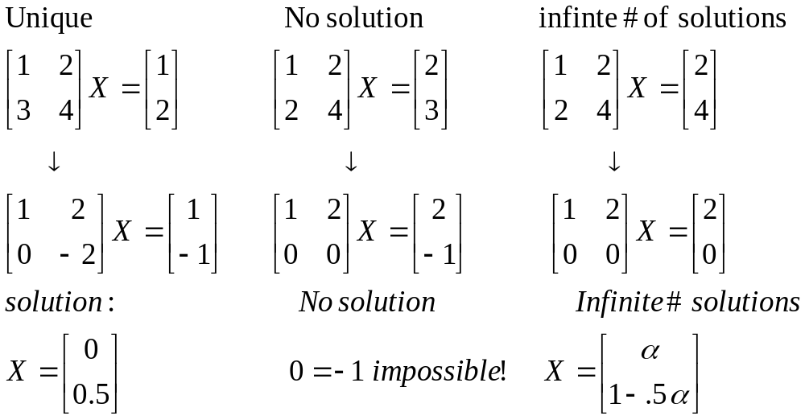
Examples
Dr Akhter Raza

Slide 39
Pseudo-Code: Forward Elimination
Do k = 1 to n-1
Do i = k+1 to n
factor = a_{i,k} / a_{k,k}
Do j = k+1 to n
a_{i,j} = a_{i,j} – factor * a_{k,j}
End Do
b_{i} = b_{i} – factor * b_{k}
End Do
End Do
Dr Akhter Raza

Slide 40
Pseudo-Code: Back Substitution
x_{n} = b_{n} / a_{n,n}
Do i = n-1 downto 1
sum = b_{i}
Do j = i+1 to n
sum = sum – a_{i,j} * x_{j}
End Do
x_{i} = sum / a_{i,i}
End Do
Dr Akhter Raza

Slide 41
Lectures 15-16:
Gaussian Elimination with Scaled Partial Pivoting
Problems with Naive Gaussian Elimination
Definitions and Initial step
Forward Elimination
Backward substitution
Example
Dr Akhter Raza

Slide 42
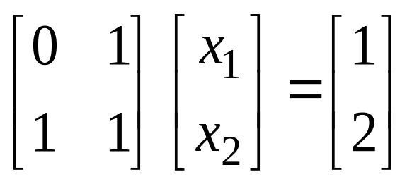
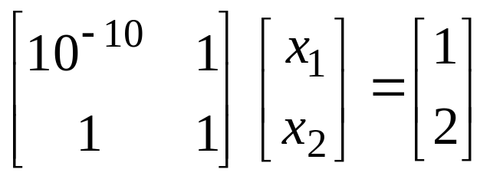
Problems with Naive Gaussian Elimination
The Naive Gaussian Elimination may fail for very simple cases. (The pivoting element is zero).
Very small pivoting element may result in serious computation errors
Dr Akhter Raza

Slide 43
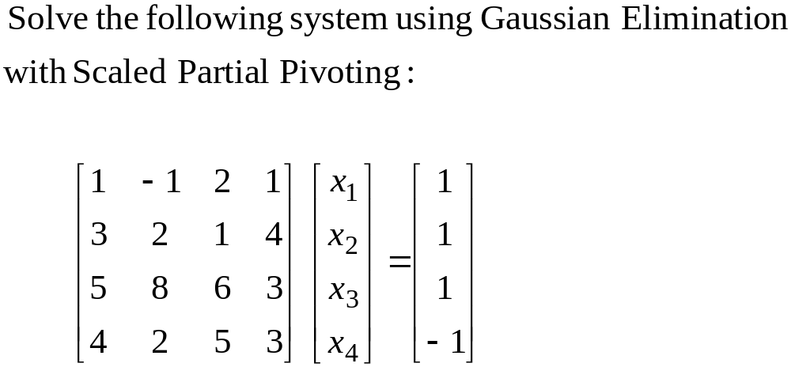
Example 2
Dr Akhter Raza

Slide 44
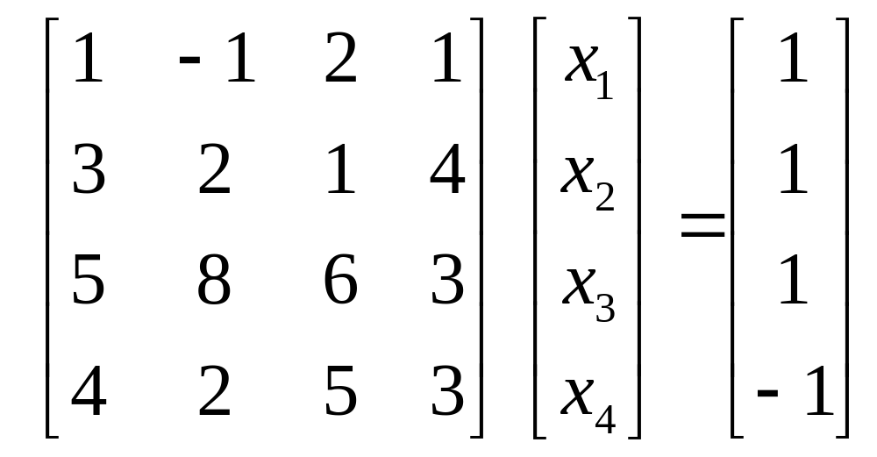
Example 2
Initialization step
disregard sign
find largest in magnitude in first column
Exchange the row having max with the first row
Then proceed with the Naïve Gaussian method
Dr Akhter Raza

Slide 45
Example 2
Initialization step 2
disregard sign of second column after first row
find largest in magnitude in 2nd column
Exchange the row having max with the 2nd row
And proceed in the same way as the naïve Gaussian
Dr Akhter Raza

Slide 46
Lecture 17
Tridiagonal & Banded Systems and Gauss-Jordan Method
Tridiagonal Systems
Diagonal Dominance
Tridiagonal Algorithm
Examples
Gauss-Jordan Algorithm
Dr Akhter Raza

Slide 47
Gauss-Jordan Method
The method reduces the general system of equations AX=B to IX=B where I is an identity matrix.
Only Forward elimination is done and no backward substitution is needed.
It has the same problems as Naive Gaussian elimination and can be modified to do partial scaled pivoting.
It takes 50% more time than Naive Gaussian method.
Dr Akhter Raza

Slide 48
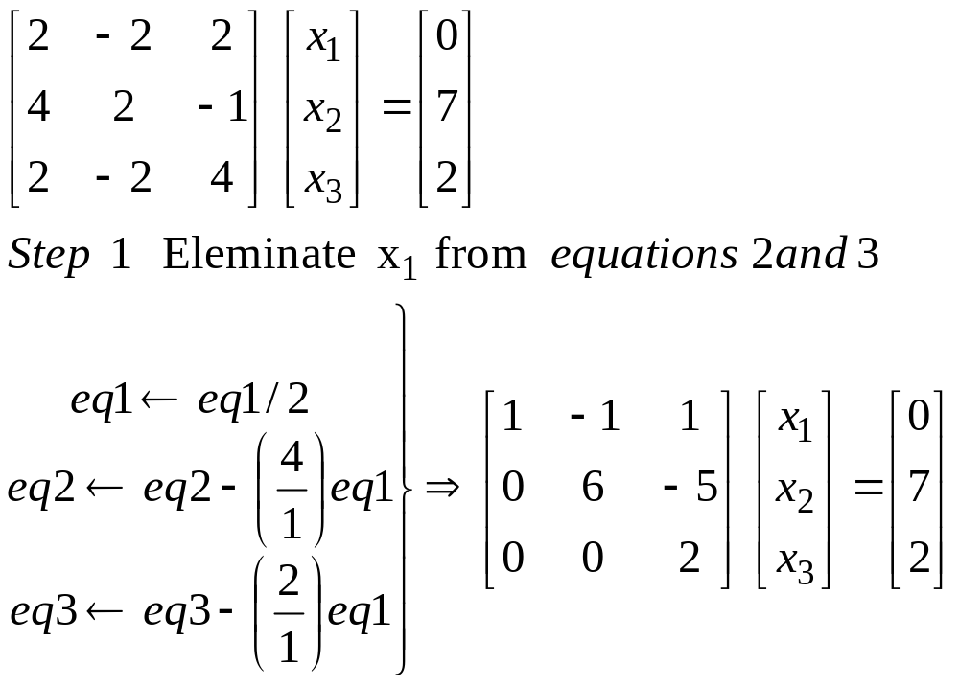
Gauss-Jordan Method
Example
Dr Akhter Raza

Slide 49
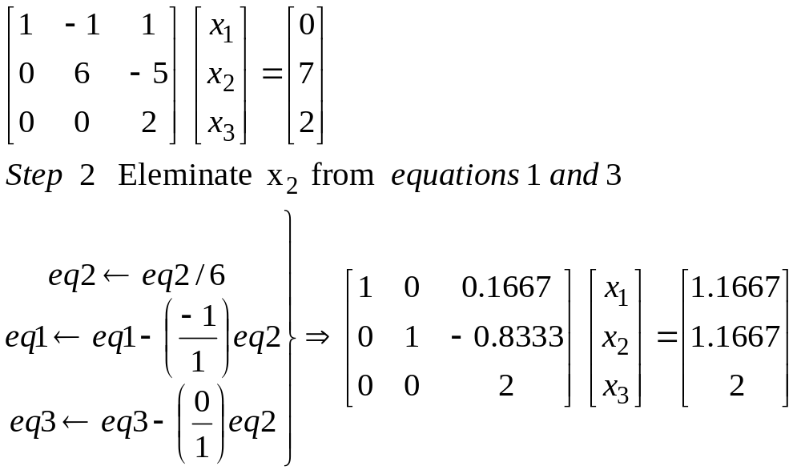
Gauss-Jordan Method
Example
Dr Akhter Raza

Slide 50
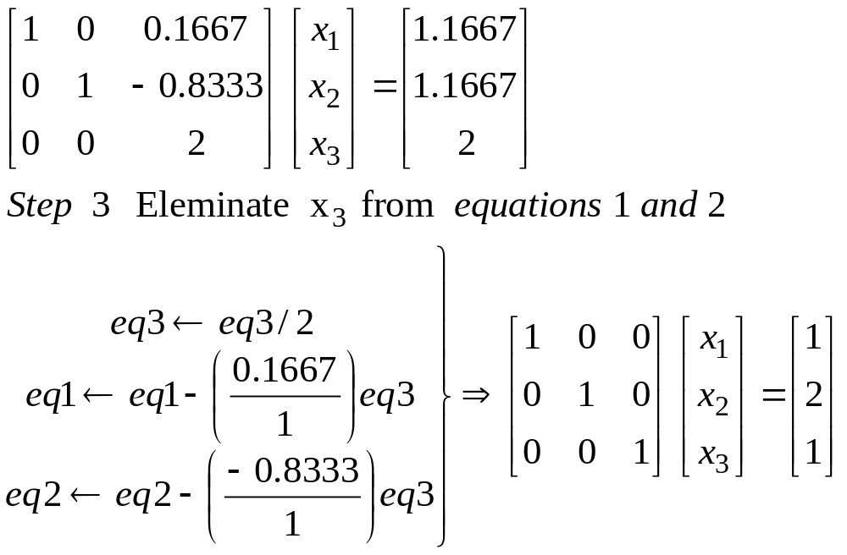
Gauss-Jordan Method
Example
Dr Akhter Raza

Slide 51
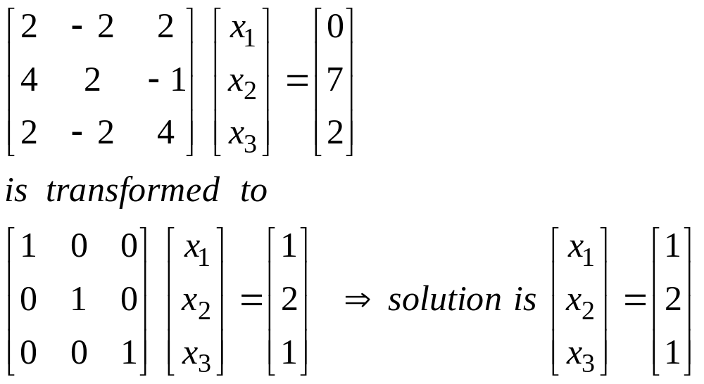
Gauss-Jordan Method
Example
Dr Akhter Raza

